Slide 1
An Overview of Performance-Based Funding in American Higher Education
Justin C. Ortagus*
Associate Professor, University of Florida
*Presentation based on collaborative work with Kelly Rosinger, Robert Kelchen, and a team of graduate research assistants

Slide 2
Background
Performance-based funding (PBF) is generally defined as a policy that links a percentage of state funding to institutional outcomes, such as retention and graduation
Approximately 9% of state general funds were allocated to public colleges and universities for performance-based funding (Rosinger et al., 2022)
  The proportion of funding linked to performance has grown over time but still varies widely across states (e.g., Arkansas, Connecticut, Michigan – fewer than 2%; Louisiana – 30%; Tennessee – 87.55%)
In FY 2024, 31 states had a funded PBF policy, with 29 including the two-year sector and 22 including the four-year sector

Slide 3
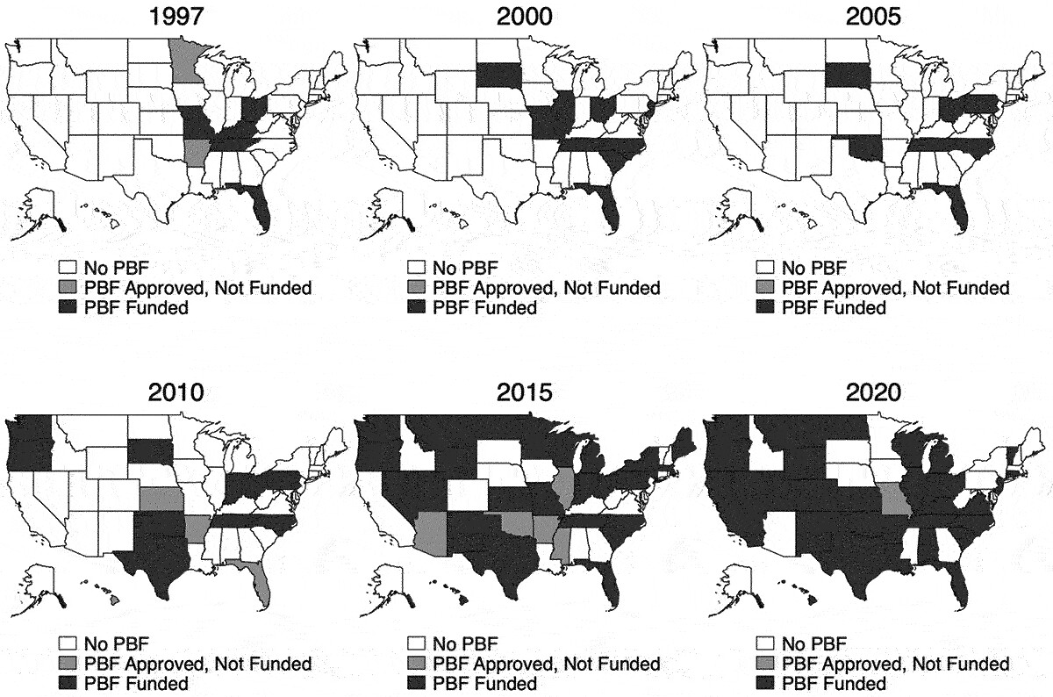
PBF Growth Over Time

Slide 4
PBF Metrics
The most common metric within PBF formulas is the number of students who complete their degree
Outcome metrics vary widely across states
  Additional outcome metrics include retention, vertical transfers, number of credit hours completed, number of students who graduate in high-demand/STEM fields, wages, etc.
Bonus metrics can also focus specifically on equity
  Equity metrics include incentives for the graduation of low-income students, racially minoritized students, adult students, first-generation students, academically underprepared students, veteran students, etc.

Slide 5
PBF Bonus Metrics (FY 2024)

Slide 6
A Need for Better Evidence
PBF isn’t going anywhere, so the focus should shift to how we can design more equitable, effective PBF policies
Studies focused on binary measures of PBF adoption fail to capture the complexity and variety of PBF policies
Our work has tackled this issue and considers the dosage and design of PBF policies to better understand what (if anything) currently works in PBF systems
  Focus on both intended and unintended consequences

Slide 7
Brief Summary of Our Work on PBF
Here’s what we know: PBF typically leads to null or modest positive effects on retention and graduation (i.e., intended outcomes)
Prior work also suggests that PBF can lead to unintended outcomes
  PBF can: restrict access, lead to gamification, and exacerbate disadvantages for underserved students and under-resourced institutions
I will provide some high-level findings from some of our recent empirical work on PBF
  Access, completions, and institutional revenue

Slide 8
PBF and Access
Some evidence suggesting that increases in the share of revenue at stake are associated with decreases in racially minoritized student enrollment
  Exacerbated among selective institutions
A key point is that PBF will not expand access and reduce inequities at four-years regardless of design
  Equity metrics are helpful at moderately or less-selective four-years, but they’re unlikely to help at the most-selective institutions

Slide 9
PBF and Completions
When we look at pooled effects of the presence of PBF, we show there’s no impact on completions
  Driven by low-dosage PBF policies
High-dosage PBF at four-years has a negative influence on bachelor’s degree completion among racially minoritized students
    Positive impact on bachelor’s degree completion among White students
    Positive impact on bachelor’s degree completion when there’s a targeted adult student incentive
No relationship between any type of funded PBF policy and associate degree completion
  A note on certificates and prior literature

Slide 10
PBF and Institutional Revenue
Once again, when we look at the presence of any funded PBF policy, it had no effect on state appropriations among PBF-adopting four-years
  High-dosage PBF policies had a negative effect on state appropriations for four-year HBCUs and four-year institutions serving an above-average share of racially minoritized students
The picture among community colleges is a bit more complex
  Generally speaking, PBF policies had a modest positive influence on state appropriations among community colleges that were non-MSIs or serving a below-average share of racially minoritized or low-income students
  Modest negative influence on state appropriations among community colleges that were MSIs or serving an above-average share of racially minoritized students

Slide 11
Implications
A consistent theme linked to PBF results: Advantages for the advantaged and disadvantages for the disadvantaged
  Design elements focused on equity-oriented metrics can mitigate these harms
PBF is a bipartisan policy that may be necessary to ensure adequate funding for HI ED
  Important not to dismiss PBF given that the alternative would likely be less funding
  Policymakers typically think of PBF as more of a signal than a panacea
Our ongoing work will update PBF data through FY 2024 and look at the impacts associated with updated PBF policies

Slide 12

Thank you!
Email: jortagus@coe.ufl.edu

