Slide 1
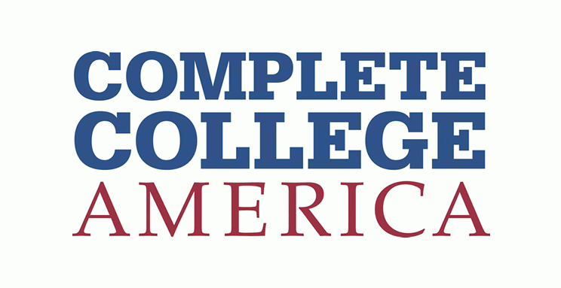
Funding for Student Success
Performance-based Funding Council
January 14, 2025

Slide 2
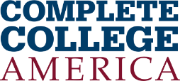
Our Mission
Complete College America (CCA) is a bold national advocate for dramatically increasing college completion rates and closing institutional performance gaps by working with states, systems, institutions, and partners to scale highly effective structural reforms and promote policies that improve student success.

Slide 3
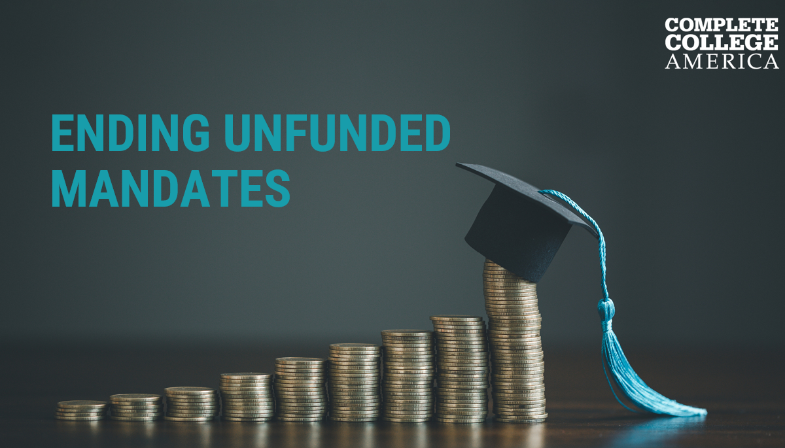
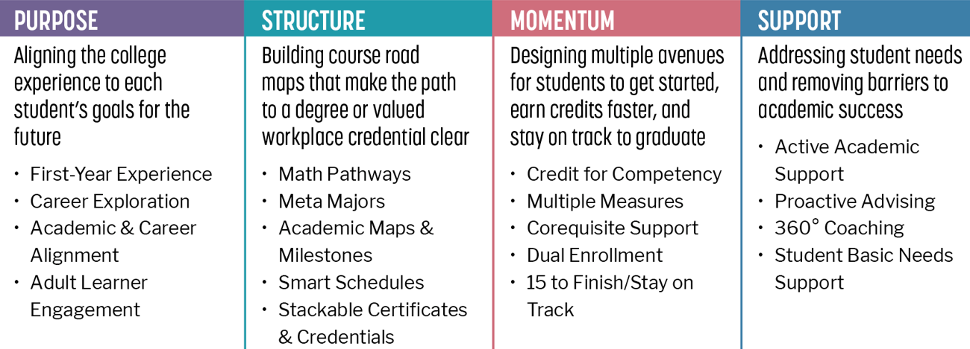
We must commit to the right practices and policies, manage them well, and advocate for funding them in alignment with stated attainment goals
Implement the Pillars |  | Manage the metrics |  | Fund Completion Goals
We know the reforms that work, that help combat the fact that time is the enemy of college completion. We must scale them – in policy, and in technology. |  | Progress on key metrics drive reform efforts. It is not enough to understand the nuances of student reality – you have to measure your own progress over time, relating the work to the KPI’s. |  | Adequately funding higher education is nothing without accountability, and vice versa. Both the size of the budgetary pie and its slicing require performance evaluation.

Slide 4
By 2031, 65 percent of jobs in Pennsylvania will require some college education. Current-state is 54 percent. (1/2)
Percent of public two-year
students graduating in two years
Enrollment trend,
Spring 2020 – Spring 2024
Postsecondary Attainment
Public, two-year
65%
13%
-23%
104,606
54%
Public, four-year
80,987
-11%
38%
Attainment
goal
Percent of public four-year
students graduating in four years
256,461
228,111
Certificate or higher
Number of Pennsylvania residents with
some college but no degree
46%
Baccalaureate degree
or higher
1,023,642
Source: https://nces.ed.gov/ipeds; https://nscresearchcenter.org/some-college-no-credential/; https://nscresearchcenter.org/current-term-enrollment-estimates/; https://www.luminafoundation.org/stronger-nation/report/#/progress

Slide 5
By 2031, 65 percent of jobs in Pennsylvania will require some college education. Current-state is 54 percent. (2/2)
2031 projections for occupational sectors are listed below, expressed in thousands of jobs
1,415
Bachelor’s-plus
1,283
Associate’s and
certificates
926
821
710
High school
diploma or less
395
364
216
29
37
23
14
34
Blue-Collar
Sales and Office Support
Healthcare
Food and Personal Services
Managerial and Professional Services
Education
STEM
Community Services and Arts
Source: https://cew.georgetown.edu/cew-reports/projections2031/#resources;
https://www.luminafoundation.org/stronger-nation/report/#/progress/state/PA

Slide 6
Evolution in performance-based funding: combining accountability and transparency with student success goals (1/2)
The need to accelerate towards college completion
Even under funding models that prioritize college completion, most states are not on track to meet completion goals—or to meet workforce needs, or needs for engaged citizenship and a vibrant democracy.
Outcomes-based funding pushed appropriations mechanisms and actors to have a student success orientation, which is a critical step
We now must tighten appropriations to college completion and prioritize fields of study and institutions required to meet attainment goals.
Completion-goals funding
Funding is based on the actual cost of educating enough students to reach statewide completion goals—specifically increasing attainment of degrees that meet workforce needs, allow students to earn a livable wage, and can lead to ongoing education.
Colleges get upfront dollars to implement proven strategies rather than after-the-fact rewards.
States and institutions work together to determine the actual cost of giving every student the highest chance of earning credentials, using cost-per-graduate as the adequacy base.
Funding includes both investing in proven success strategies and eliminating inefficiencies.

Slide 7
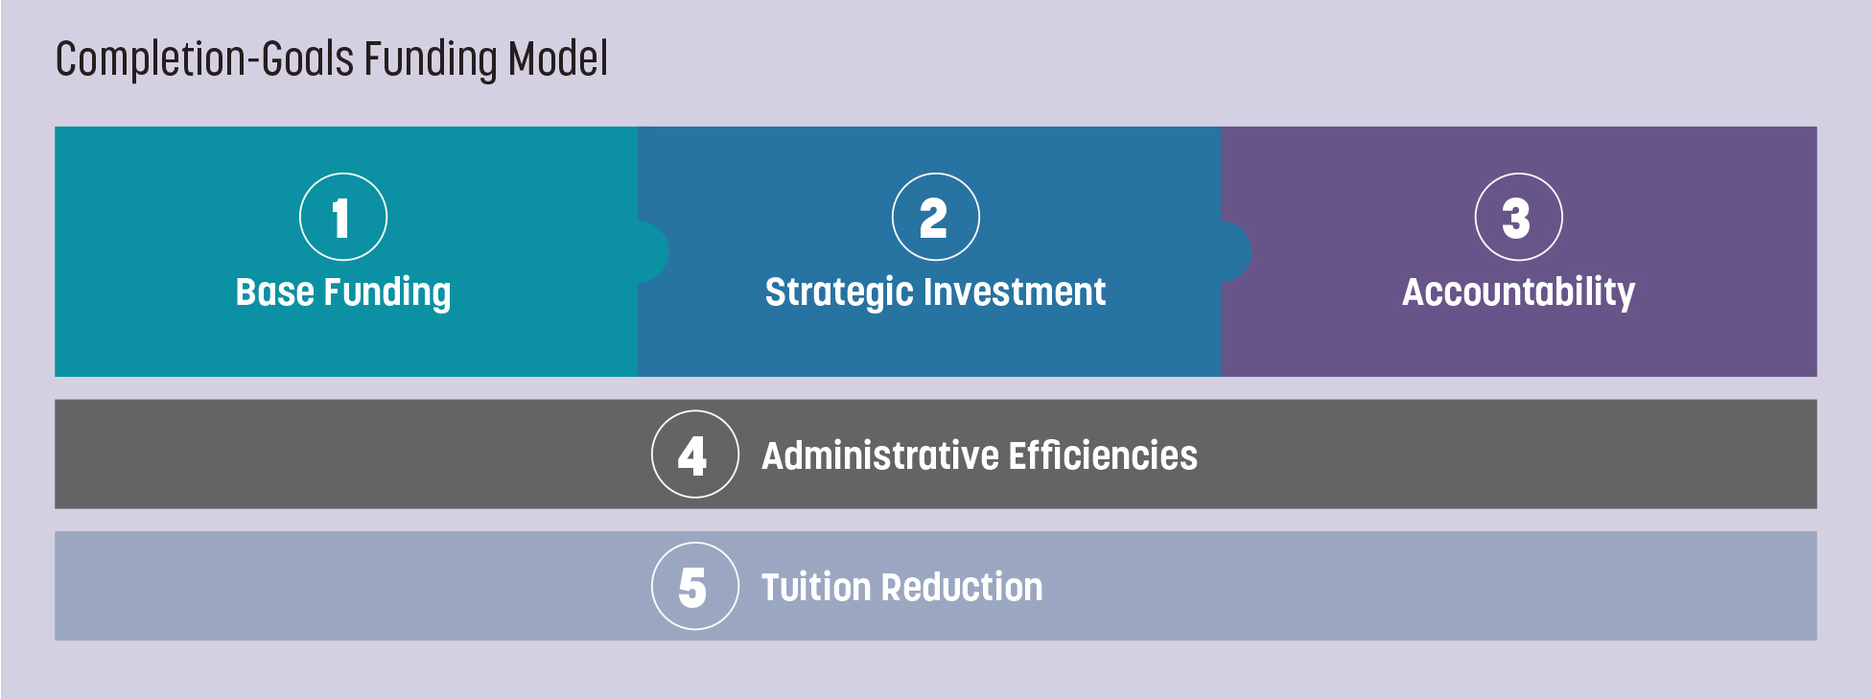
Evolution in performance-based funding – combining accountability and transparency with student success goals (2/2)

Slide 8
Beyond Enrollment: Building Success-Oriented Funding Models
Strategic investment funding is upfront for institutions to use to implement proven reforms—and scale change so they produce more credential holders.
Each institution will set targets, with time frames, for improving leading indicators related to completion, which ultimately leads population-wide attainment.
Process metrics will be as important as outcomes metrics
Create base funding grounded entirely in completion goals, rather than only some student success metrics atop mostly enrollment numbers or historical precedence.
Embrace strategic investment for reform efforts because sustainable improvements require not just one-off funding but consistent, committed investment in innovative strategies and proven best practices.
Uphold - and introduce new - accountability metrics to ensure that every dollar spent yields tangible, meaningful progress toward shared educational objectives.

